Slide 1
Continuous Delivery and Telerik Sitefinity
Radoslav Georgiev
Senior Director, Engineering
Christopher Woodard
Technical Consultant

Slide 2
Agenda
Demos
Continuous Delivery in a nutshell
Why implement it?
Deployment Pipeline (with example)
How does Sitefinity fit in?
Q&A

Slide 3
Demo 1 – from commit to live deployment

Slide 4
Demo 2 – automate environment configuration

Slide 5
Continuous Delivery in a nutshell
Developers commit frequently
Automated builds/tests/deploys
Configuration management

Slide 6
Why implement a Continuous Delivery process?
Increase productivity
Quicker feedback
Improve quality
Reduce volatility
Improve scalability
Increased visibility
More happy customers

Slide 7
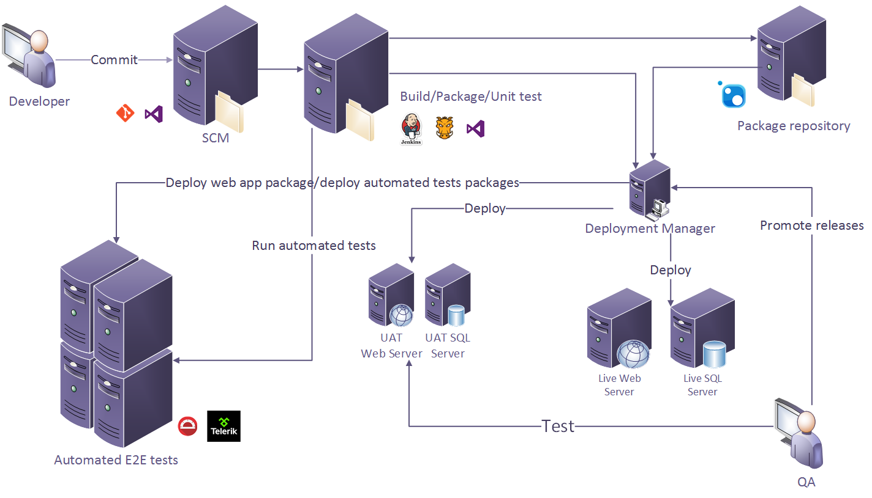
Deployment Pipeline

Slide 8
How does Sitefinity fit in?
Configuration Management
Logs and Health Monitoring
Page Pre-Compiler Tool
Custom Modules
Upgrade / Install methods
Upgrades
SiteSync

Slide 9
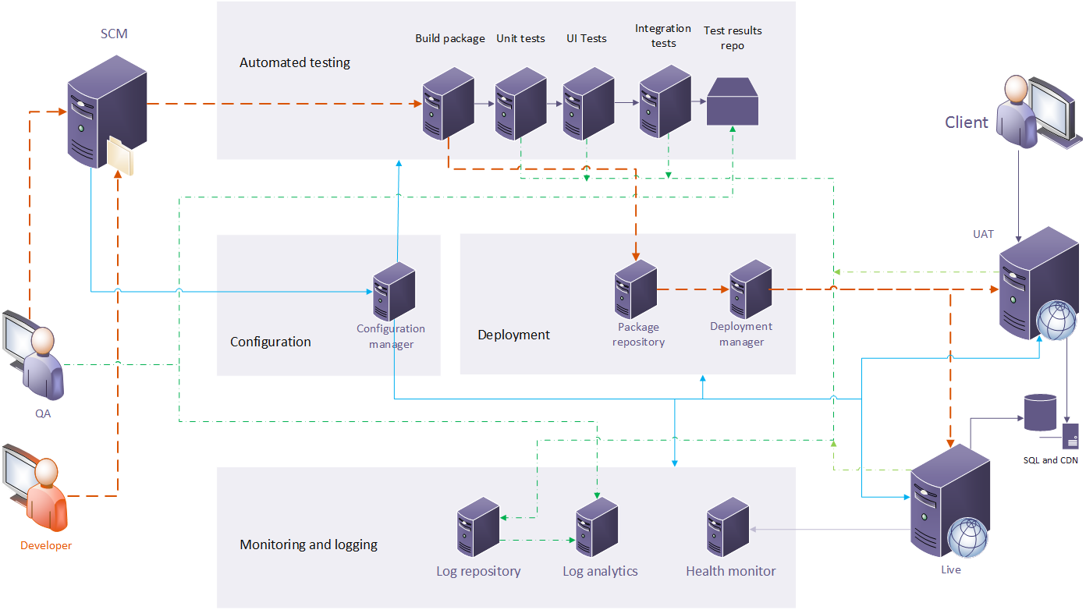
Continuous Delivery – the big picture

Slide 10
Questions?

